Slide 1
Image super-resolution with CNN and GAN
China University of Petroleum
汇报人：李皎月
Notes:
亮亮图文旗舰店https://liangliangtuwen.tmall.com

Slide 2
CONTENTS
RESEARCH INTRODUCTION
研究简介
1
ANALYSIS AND DISCUSSION
分析与讨论
3
RESEARCH METHODS
2
研究方法
CONCLUSSION AND SUGGESSTION
4
结论与建议

Slide 3
1
研究简介
RESEARCH INTRODUCTIONS

Slide 4
1
研究简介
RESEARCH INTRODUCTIONS
中国石油大学
Image super-resolution(SR), which refers to process of recovering high-resolution(HR) images from low-resolution(LR) images, is an important class of image processing techniques in computer vision and image processing.
It enjoys a wide range of real-word applications, such as medical image, surveillance an security, amongst others.

Slide 5
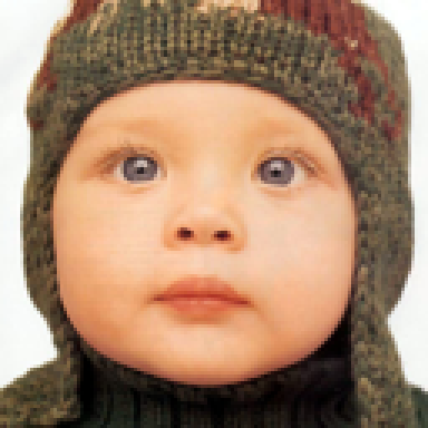
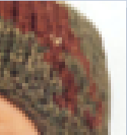


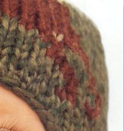
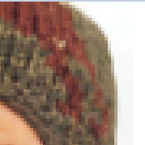
1
研究简介
RESEARCH INTRODUCTIONS
中国石油大学
What is image super-resolution?

Slide 6
2
研究方法
RESEARCH METHODS

Slide 7
2
研究方法
RESEARCH METHODS
中国石油大学
Interpolation
bicubic
Convolution Neutral Networks (CNN) based methods, such as SRCNN, VDSR
Generative Adversarial Networks (GAN) based methods, such as SRGAN,
ESRGAN
RESEARCH METHODS
Sparse coding

Slide 8

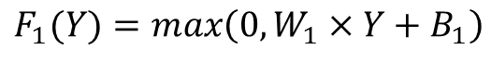
2
研究方法
RESEARCH METHODSS
SRCNN
中国石油大学
Bicubic
interpolation
First step: upscale image to the target size
using bicubic interpolation
Low-resolution
image Y
magnified low-resolution image Y
feature extraction
by CNN
Second step: extracts patches from the low
-resolution image L and represents each a high
-dimensional vector.
$$F_{1}(Y)=max\left(0,W_{1}×Y+B_{1}\right)$$
Y
n feature maps of Y
Image Super-Resolution Using Deep Convolutional Networks, Chao Dong, Chen Change Loy,
Kaiming He, Xiaoou Tang, ECCV, in 2014

Slide 9
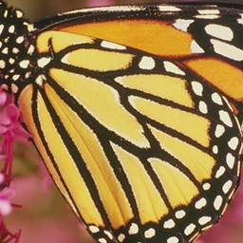
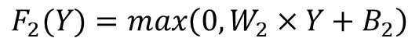
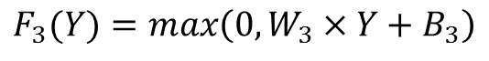
2
研究方法
RESEARCH METHODS
SRCNN
中国石油大学
CNN
Third step: map each of the n-dimension al
vectors into m-dimensional one.
m feature maps of
high-resolution images
$$F_{2}(Y)=max\left(0,W_{2}×Y+B_{2}\right)$$
n feature maps of
low-resolution image
Final step: aggregate the above high-resolution
patch-wise representations to generate the
final high-resolution image.
reconstruction
$$F_{3}(Y)=max\left(0,W_{3}×Y+B_{3}\right)$$
m feature maps of high
-resolution images
High-resolution image

Slide 10
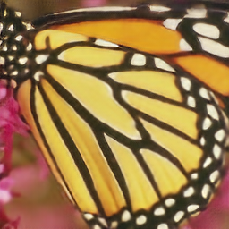
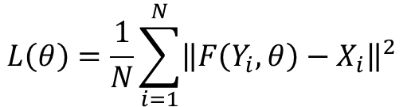
2
研究方法
RESEARCH METHODS
SRCNN
中国石油大学
How to optimize?
Mean square error
The loss function is minimized by stochastic gradient descent with the standard backpropagation.
Generated image Y
Ground truth image X
$$L\left(θ\right)=\frac{1}{N}\sum_{i=1}^{N}{{\left\|F\left(Y_{i},θ\right)−X_{i}\right\|}^{2}}$$
The estimation of parameter $θ=(W_{1},W_{2},W_{3},B_{1},B_{2},B_{3})$

Slide 11
2
研究方法
RESEARCH METHODS
SRGAN
中国石油大学
Generated image
Generator
network
Real ?
Or
Fake ?
Discriminator
network
Low-resolution
image
Real image
Photo-Realistic Single Image Super-Resolution Using a Generative Adversarial, Christian Ledig,
Lucas Theis, Ferenc Huszar, Jose Caballero, CVPR, in 2017

Slide 12
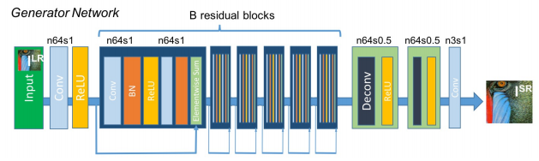
2
研究方法
RESEARCH METHODS
SRGAN
中国石油大学
Feature extraction
upscale
SRResNet: only use the generator network to conduct image SR

Slide 13
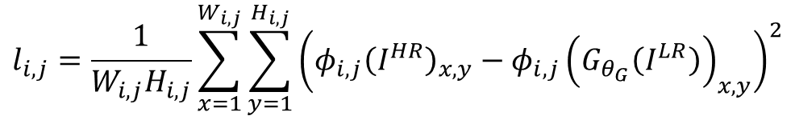
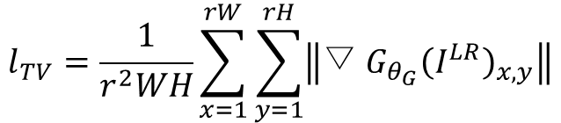
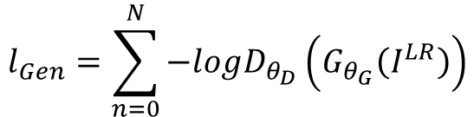
2
研究方法
RESEARCH METHODS
SRGAN
中国石油大学
$$l_{i,j}=\frac{1}{W_{i,j}H_{i,j}}\sum_{x=1}^{W_{i,j}}{\sum_{y=1}^{H_{i,j}}{{\left(φ_{i,j}{\left(I^{HR}\right)}_{x,y}−φ_{i,j}{\left(G_{θ_{G}}\left(I^{LR}\right)\right)}_{x,y}\right)}^{2}}}$$
Content loss
VGG loss
Encourage the network to favor solutions that reside on the manifold natural images, by trying to fool the discriminator network.
Generator loss functions
$$l_{Gen}=\sum_{n=0}^{N}{−logD_{θ_{D}}\left(G_{θ_{G}}\left(I^{LR}\right)\right)}$$
Adversarial loss
Regularization loss
$$l_{TV}=\frac{1}{r^{2}WH}\sum_{x=1}^{rW}{\sum_{y=1}^{rH}{\left\|▽{G_{θ_{G}}\left(I^{LR}\right)}_{x,y}\right\|}}$$
Use to denoising and
make the generated
image look smoother.

Slide 14
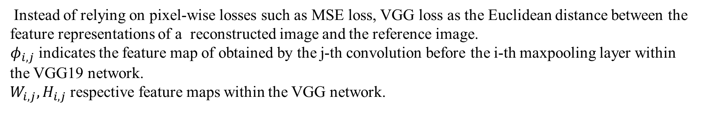
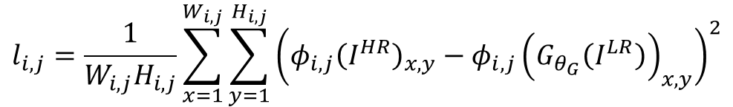
2
研究方法
RESEARCH METHODS
SRGAN
中国石油大学
Content loss
$$l_{i,j}=\frac{1}{W_{i,j}H_{i,j}}\sum_{x=1}^{W_{i,j}}{\sum_{y=1}^{H_{i,j}}{{\left(φ_{i,j}{\left(I^{HR}\right)}_{x,y}−φ_{i,j}{\left(G_{θ_{G}}\left(I^{LR}\right)\right)}_{x,y}\right)}^{2}}}$$
Instead of relying on pixel-wise losses such as MSE loss, VGG loss as the Euclidean distance between the
feature representations of a reconstructed image and the reference image.
$φ_{i,j}$ indicates the feature map of obtained by the j-th convolution before the i-th maxpooling layer within
the VGG19 network.
$W_{i,j},H_{i,j}$ respective feature maps within the VGG network.

Slide 15
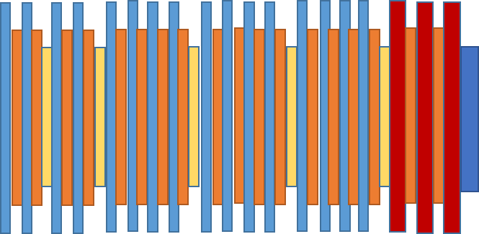
2
研究方法
RESEARCH METHODS
SRGAN
中国石油大学
Fully connection
relu
pooling
softmax
conv
relu
VGG19 Network

Slide 16
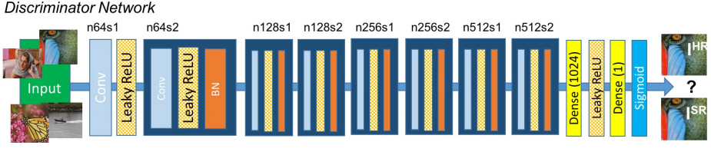
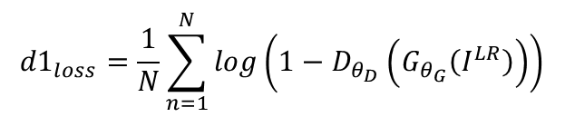
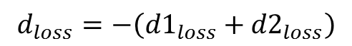
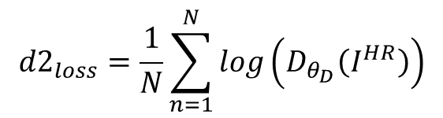
2
研究方法
RESEARCH METHODS
SRGAN
中国石油大学
Feature extraction
Loss function
$${d1}_{loss}=\frac{1}{N}\sum_{n=1}^{N}{log\left(1−D_{θ_{D}}\left(G_{θ_{G}}\left(I^{LR}\right)\right)\right)}$$
generated image
$${d2}_{loss}=\frac{1}{N}\sum_{n=1}^{N}{log\left(D_{θ_{D}}\left(I^{HR}\right)\right)}$$
real image
$$d_{loss}=−\left({d1}_{loss}+{d2}_{loss}\right)$$

Slide 17
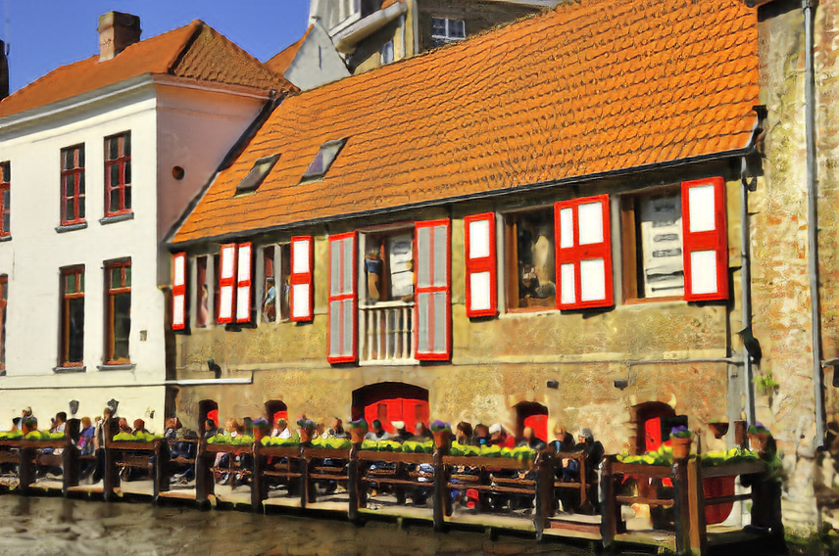


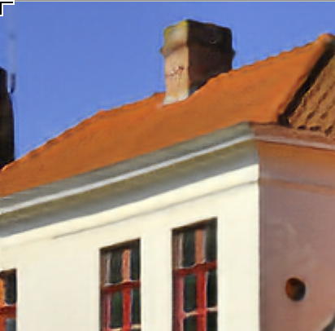
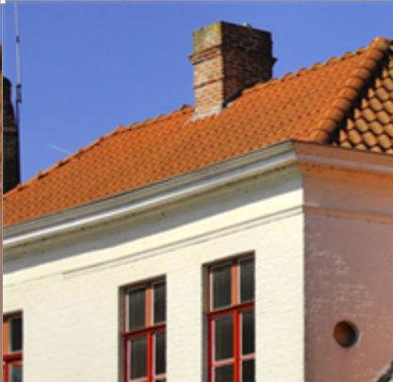
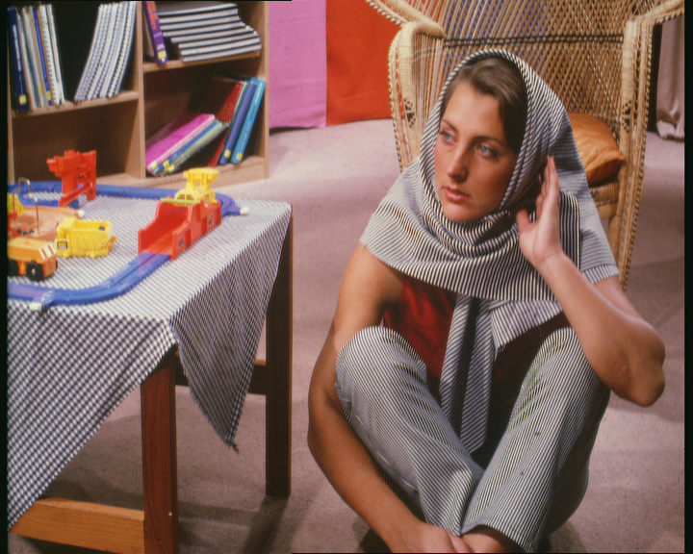


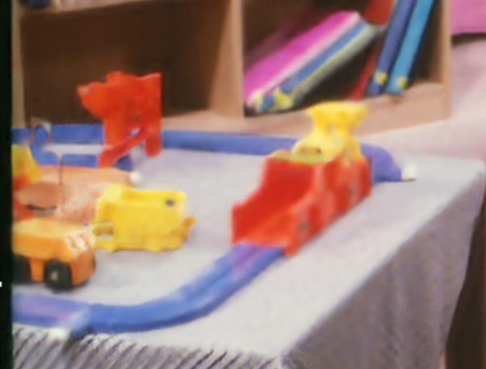





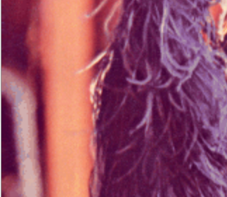
2
研究方法
RESEARCH METHODS
SRGAN
中国石油大学
input
bicubic
srgan
target

Slide 18
2
研究方法
RESEARCH METHODS
中国石油大学

Slide 19
3
分析与讨论
ANALYSIS AND DISCUSSION

Slide 20
3
分析与讨论
ANALYSIS AND DISCUSSION
中国石油大学
A: Low-resolution image acquisition
C: upscale epoch
Both of the SRCNN and SRGAN approaches need degradation process to get LR images
SRCNN : before the feature
extraction epoch
SRGAN: after the feature
extraction stage
Differences and similarities
B: Compared with ground truth
others
Both of the SRGAN and SRCNN approaches need the differences between the generated images and high-resolution images during training.

Slide 21
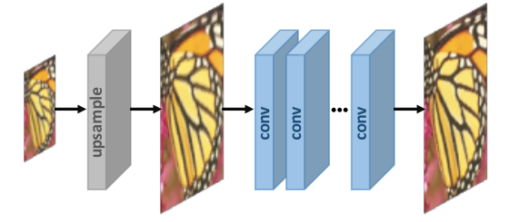
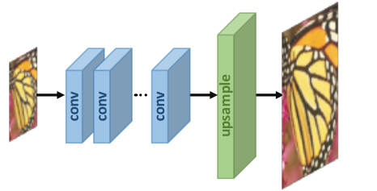
3
分析与讨论
ANALYSIS AND DISCUSSION
中国石油大学
This is a straightforward solution and upscale
stage has been done, CNN only refines the coarse
image, which reduces the learning difficulty.
Most processes are performed in high-dimension
space, the cost of time and space is higher than other
methods.
Because of the feature extraction only performs
in low-dimension space and the upsampling process
in the last stage, so the cost of training time and space
is reduced a lot.
The upsampling operation is performed only one step,
so greatly increases the learning difficult for large-scale
factors. The model can not achieve multi-scale SR.

Slide 22
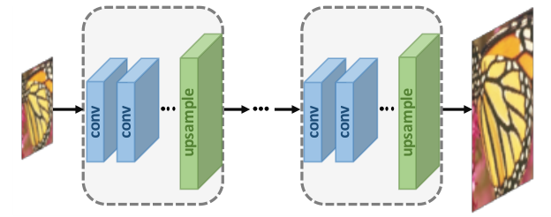
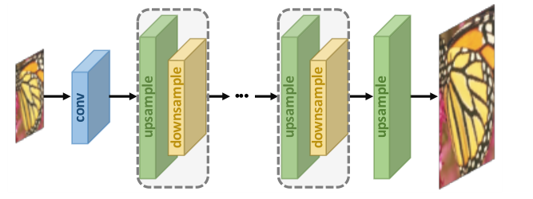
3
分析与讨论
ANALYSIS AND DISCUSSION
中国石油大学
This the model under the framework are based on a
cascade of CNNs and progressively reconstruct
high-resolution images. At each stage, the images are
upsampled to higher solution and refined by CNNs,
this model can cope with multi-scale SR.
The drawbacks of the model are difficult training and
complicated model designing.
Mutually connect upsampling layers and downsampling
layers alternately and reconstruct the final HR result using
concatenation of all the intermediately reconstructed HR
feature maps.
The design criteria of the back-projection modules are still
unclear, the framework has great potential and needs
further exploration.

Slide 23
4
结论与建议
CONCLUSSION AND SUGGESTIONS
中国石油大学
The methods described in part 2 are the mainstream methods and they have got good results, but all the methods need LR-HR image pairs, however, sometimes we can only get the HR images, so we need to process HR images to obtain LR images. Nevertheless, the SR models to train the LR images to generate HR images are likely reverse operations of pre-process.
In order to solve said problem, many researchers pay attention to unsupervised super-resolution which don’t require LR-HR image pairs.

Slide 24
THANKS

